Slide 1
07. Generic Programming

Slide 2
Generic Classes and Type Parameters
Generic programming: creation of programming constructs that can be used with many different types
  In Java, achieved with type parameters or with inheritance
  Type parameter example: Java's ArrayList (e.g. ArrayList<String>)
  Inheritance example: LinkedList
Generic class: declared with one or more type parameters
A type parameter for ArrayList denotes the element type:
  public class ArrayList<E>
  {
  public ArrayList() { . . . }
  public void add(E element) { . . . }
  . . .
  }

Slide 3
Type Parameters
Can be instantiated with class or interface type:
  ArrayList<BankAccount>
  ArrayList<Measurable>
Cannot use a primitive type as a type variable:
  ArrayList<double> // Wrong!
Use corresponding wrapper class instead:
  ArrayList<Double>

Slide 4
Type Parameters
Supplied type replaces type variable in class interface
Example: add in ArrayList<BankAccount> has type variable E replaced with BankAccount:
  public void add(BankAccount element)
Contrast with LinkedList.add:
  public void add(Object element)

Slide 5
Type Parameters Increase Safety
Type parameters make generic code safer and easier to read
  Impossible to add a String into an ArrayList<BankAccount>
  Can add a String into a LinkedList intended to hold bank accounts
  ArrayList<BankAccount> accounts1 = new ArrayList<BankAccount>();
  LinkedList accounts2 = new LinkedList();
  accounts1.add("my savings");
  // Compile-time error
  accounts2.add("my savings");
  // Not detected at compile time
  . . .
  BankAccount account = (BankAccount) accounts2.getFirst();
  // Run-time error

Slide 6
Implementing Generic Classes
Example: simple generic class that stores pairs of objects such as:
  Pair<String, BankAccount> result =
  new Pair<String, BankAccount>("Harry Hacker",
  harrysChecking);
Methods getFirst and getSecond retrieve first and second values of pair:
  String name = result.getFirst();
  BankAccount account = result.getSecond();
Example of use: return two values at the same time (method returns a Pair)
Generic Pair class requires two type parameters, one for each element type enclosed in angle brackets:
  public class Pair<T, S>

Slide 7
Good Type Variable Names
Type Variable | Name Meaning
E | Element type in a collection
K | Key type in a map
V | Value type in a map
T | General type
S, U | Additional general types

Slide 8
Class Pair
public class Pair<T, S>
{
private T first;
private S second;
public Pair(T firstElement, S secondElement)
{
first = firstElement;
second = secondElement;
}
public T getFirst() { return first; }
public S getSecond() { return second; }
}

Slide 9
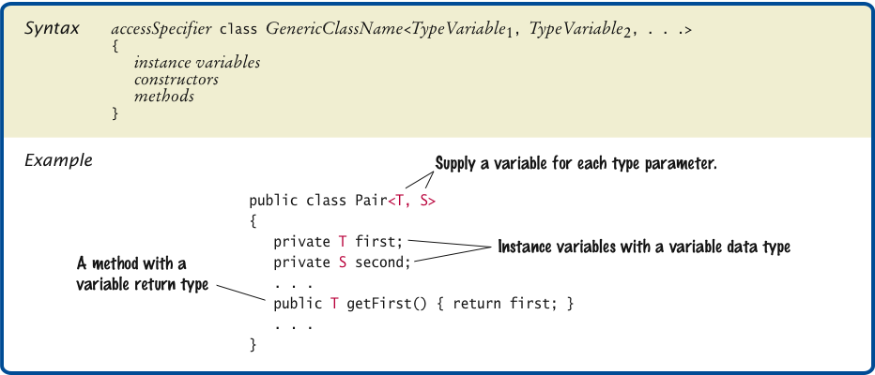
Declaring a Generic Class

Slide 10
Pair.java
1 /**
2 This class collects a pair of elements of different types.
3 */
4 public class Pair<T, S>
5 {
6 private T first;
7 private S second;
8
9 /**
10 Constructs a pair containing two given elements.
11 @param firstElement the first element
12 @param secondElement the second element
13 */
14 public Pair(T firstElement, S secondElement)
15 {
16 first = firstElement;
17 second = secondElement;
18 }
19

Slide 11
Pair.java (cont.)
20 /**
21 Gets the first element of this pair.
22 @return the first element
23 */
24 public T getFirst() { return first; }
25
26 /**
27 Gets the second element of this pair.
28 @return the second element
29 */
30 public S getSecond() { return second; }
31
32 public String toString() { return "(" + first + ", " + second + ")"; }
33 }

Slide 12
PairDemo.java
1 public class PairDemo
2 {
3 public static void main(String[] args)
4 {
5 String[] names = { "Tom", "Diana", "Harry" };
6 Pair<String, Integer> result = firstContaining(names, "a");
7 System.out.println(result.getFirst());
8 System.out.println("Expected: Diana");
9 System.out.println(result.getSecond());
10 System.out.println("Expected: 1");
11 }
12

Slide 13
PairDemo.java (cont.)
13 /**
14 Gets the first String containing a given string, together
15 with its index.
16 @param strings an array of strings
17 @param sub a string
18 @return a pair (strings[i], i) where strings[i] is the first
19 strings[i] containing str, or a pair (null, -1) if there is no
20 match.
21 */
22 public static Pair<String, Integer> firstContaining(
23 String[] strings, String sub)
24 {
25 for (int i = 0; i < strings.length; i++)
26 {
27 if (strings[i].contains(sub))
28 {
29 return new Pair<String, Integer>(strings[i], i);
30 }
31 }
32 return new Pair<String, Integer>(null, -1);
33 }
34 }
Continued

Slide 14
PairDemo.java (cont.)
Program Run:
  Diana
  Expected: Diana
  1
  Expected: 1

Slide 15
Question?
What is the difference between an
ArrayList<Pair<String, Integer>> and a
Pair<ArrayList<String>, Integer>?

Slide 16
Generic Methods
Generic method: method with a type variable
Can be defined inside non-generic classes
Example: Want to declare a method that can print an array of any type:
  public class ArrayUtil
  {
  /**
  Prints all elements in an array.
  @param a the array to print
  */
  public <T> static void print(T[] a)
  {
  . . .
  }
  . . .
  }

Slide 17
Generic Methods
    Often easier to see how to implement a generic method by starting with a concrete example; e.g. print the elements in an array of strings:
    public class ArrayUtil
    {
  public static void print(String[] a)
  {
  for (String e : a)
  System.out.print(e + " ");
  System.out.println();
  }
  . . .
  }

Slide 18
Generic Methods
In order to make the method into a generic method:
  Replace String with a type parameter, say E, to denote the element type
  Supply the type parameters between the method's modifiers and return type
    public static <E> void print(E[] a)
    {
    for (E e : a)
    System.out.print(e + " ");
    System.out.println();
    }

Slide 19
Generic Methods
When calling a generic method, you need not instantiate the type variables:
  Rectangle[] rectangles = . . .;
  ArrayUtil.print(rectangles);
The compiler deduces that E is Rectangle
You can also define generic methods that are not static
You can even have generic methods in generic classes
Cannot replace type variables with primitive types
e.g.: cannot use the generic print method to print an array of type int[]

Slide 20
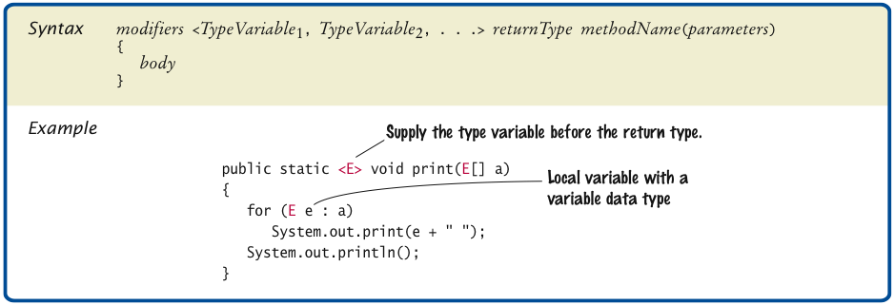
Defining a Generic Method

Slide 21
Constraining Type Variables
Type variables can be constrained with bounds:
public static <E extends Comparable> E min(E[] a)
{
E smallest = a[0];
for (int i = 1; i < a.length; i++)
if (a[i].compareTo(smallest) < 0) smallest = a[i];
return smallest;
}
Can call min with a String[] array but not with a Rectangle[] array
Comparable bound necessary for calling compareTo
Otherwise, min method would not have compiled

Slide 22
Constraining Type Variables
Very occasionally, you need to supply two or more type bounds:
  <E extends Comparable & Cloneable>
extends, when applied to type variables, actually means
“extends or implements”
The bounds can be either classes or interfaces
Type variable can be replaced with a class or interface type

Slide 23
Wildcard Types
Name | Syntax | Meaning
Wildcard with lower bound | ? extends B | Any subtype of B
Wildcard with higher bound | ? super B | Any supertype of B
Unbounded wildcard | ? | Any type

Slide 24
Wildcard Types
public void addAll(LinkedList<? extends E> other)
{
ListIterator<E> iter = other.listIterator();
while (iter.hasNext()) add(iter.next());
}
public static <E extends Comparable<E>> E min(E[] a)
public static <E extends Comparable<?
super E>> E min(E[] a)
static void reverse(List<?> list)
You can think of that declaration as a shorthand for
  static void <T> reverse(List<T> list)

Slide 25
Type Erasure
The virtual machine erases type parameters, replacing them with their bounds or Objects
For example, generic class Pair<T, S> turns into the following raw class:
  public class Pair
  {
  private Object first;
  private Object second;
  public Pair(Object firstElement, Object secondElement)
  {
  first = firstElement;
  second = secondElement;
  }
  public Object getFirst() { return first; }
  public Object getSecond() { return second; }
  }
Continued

Slide 26
Type Erasure
Same process is applied to generic methods:
  public static Comparable min(Comparable[] a)
  {
  Comparable smallest = a[0];
  for (int i = 1; i < a.length; i++)
  if (a[i].compareTo(smallest) < 0) smallest = a[i];
  return smallest;
  }

Slide 27
Type Erasure
Knowing about raw types helps you understand limitations of Java generics
For example, trying to fill an array with copies of default objects would be wrong:
  public static <E> void fillWithDefaults(E[] a)
  {
  for (int i = 0; i < a.length; i++)
  a[i] = new E(); // ERROR
  }
Type erasure yields:
  public static void fillWithDefaults(Object[] a)
  {
  for (int i = 0; i < a.length; i++)
  a[i] = new Object(); // Not useful
  }

Slide 28
Type Erasure
To solve this particular problem, you can supply a default type:
  public static <E> void fillWithDefaults(E[] a,
  E defaultValue)
  {
  for (int i = 0; i < a.length; i++)
  a[i] = defaultValue;
  }

Slide 29
Type Erasure
You cannot construct an array of a generic type:
  public class Stack<E>
  {
  private E[] elements;
  . . .
  public Stack()
  {
  elements = new E[MAX_SIZE]; // Error
  }
  }
Because the array construction expression new E[] would be erased to new Object[]

Slide 30
Type Erasure
One remedy is to use an array list instead:
  public class Stack<E>
  {
  private ArrayList<E> elements;
  . . .
  public Stack()
  {
  elements = new ArrayList<E>(); // Ok
  }
  }

